Slide 1

Timetable Management System
PROJECT BY:
A KASTURI (59) A THANUJA (55)
JUSTIN CLARKE (56) G ADITYA SHARMA (53)

Slide 2

PROJECT DESCRIPTION:
The main theme of this project is to generate the Timetable by taking the faculty list, Department list, Subjects list and Time schedule as input and generates the Timetable by satisfying all the constraints.
The Admin was given with special privileges to add/modify the faculty details of the Department, Subject details, Period Scheduling. Add/View/Delete a Timetable. The Admin can login to the website and make changes according to his wish.
Similarly the faculty does have their own credentials to enter into the site and watch the class wise Timetable.

Slide 3

REQUIREMENT ANALYSIS:
System User Management
User management describes the ability for administrators to manage user access to various IT resources like systems, devices, applications, storage systems, network, and more. User management is a core part to any directory service and is a basic security essential for any organization.
Login Management
User management describes the ability for administrators to manage user access to various IT resources like systems, devices, applications. User management is a core part to any directory service and is a basic security essential for any organization. User management enables admins to control user access and on-board and off-board users to and from IT resources.

Slide 4
Subject Management
Subjects are the category names that are associated to specific learning objects to help users find learning. These subject names can be used by users when searching for teaching. When a user filters teaching by subject, only the learning associated with the subject displays.
Room Management
In this category we allot classrooms to each section in a Department.
Faculty Management
Faculty Management software allows you to maintain comprehensive faculty management information, including qualifications and skill sets, contract documents, define triggers to remind faculty and administrators of contract expiry dates and more, in the Faculty Management system.

Slide 5

Timetable Management
Timetable Management System contains a database, which stores the staff and students' personal details. The College Timetable system is a very useful system for Students, Faculties & Administrator through which students/parents can get the information about them/their schedule.

Slide 6
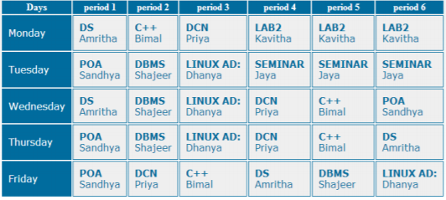
VERIFICATION AND VALIDATION

Slide 7
RESULT ANALYSIS
We have a written a code for Timetable Management. Automatic Timetable Generator is an application for generating timetable automatically. It is a great difficult task that to manage many Faculty's and allocating subjects for them at a time manually. So the proposed system will help to overcome this disadvantage. Thus we can generate timetable for any number of courses and multiple semesters. This system will help to create dynamic pages so that for implementing such a system we can make use of the different tools are widely applicable and free to use also.

Slide 8
IDENTIFY LIMITATIONS AND FUTURE WORK
The main limitation of the Timetable Management System is that it is not linking to the current database. This is because if the system connects to the current database the requirement for the hardware and software is higher.
From this Timetable system, we are able to obtain useful information for future work.
Further development includes expanding algorithm for solving timetabling problem of more than one department at same time.
We can also improve modeling and search technique , reducing execution time and enhancing graphical user interface.

Slide 9

REFERENCES / BIBILIOGRAPHY
BOOKS
Software Engineering Fifth edition by R. S. Pressman, McGraw-Hill Publication, 1997
WEBSITES
http://en.wikipedia.org/wiki/MySQL
http://www.wpi.edu/Serlvets & JSP - Falkner Jones.pdf
http://edutechwiki.unige.ch/en/Educational_technology
http://www.wpi.edu/Images/Tutorial_JSP
http://en.wikipedia.org/wiki/JSP

